Slide 1
FSK
1375003
KyungSil Kim
ks_tina@naver.com
Department of Electronics Engineering
Ewha Womans University

Slide 2
Study and explain FSK (Frequency Shift Keying)
The binary version of FM is called the Frequency Shift Keying or FSK
What is the main difference between FSK and FM?
  The frequency does not keep changing gradually over symbol time
  Changes in discrete amounts in response to a message similar to binary PSK where phase change is discrete.
  A frequency modulation scheme in which digital information is transmitted through discrete frequency changes of a carrier wave.
  The simplest FSK is Binary FSK (BFSK). BFSK literally implies using a couple of discrete frequencies to transmit binary (0s and 1s) information. With this scheme, the "1" is called the mark frequency and the "0" is called the space frequency.

Slide 3
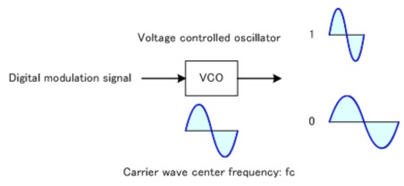
Draw a FSK signal for bitstream,
1, 1, 0, 0, 1, 0 generated based on the circuit

Slide 4


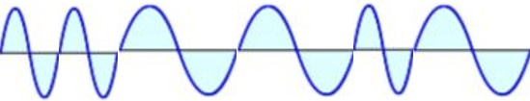
Draw a FSK signal for bitstream,
1, 1, 0, 0, 1, 0 generated based on the circuit
1
0
FSK
1
1
0
0
1
0

